Slide 1
Credit and Loans
BEFORE PRESENTING THIS MATERIAL:
ADD YOUR NAME TO THE FIRST PAGE
PRACTICE THE PRESENTATION FOR TIMING
REVIEW PRESENTER NOTES TO BECOME FAMILIAR WITH THE INFO / SLIDES
PUT PRESENTATION INTO ‘SLIDE SHOW’ MODE TO CLICK THROUGH THE PRESENTATION AND USE THE INTERACTIVE ELEMENTS.
DELETE THIS MESSAGE BEFORE PRESENTING.
Presenter Name
Notes:
NOTE: When conducting a Hands on Banking financial education activity, you cannot promote any specific Wells Fargo products or services during your presentations.
LESSON CONCEPT – Learning about Credit and Loans
LESSON OBJECTIVE – Participants learn about credit, credit cards, loans and credit scores / reports.
MATERIALS NEEDED
For you:
Personal Computer
Internet Access
Projector
PowerPoint Presentation
Participant
Tablet / Computer with Internet Access (optional)
Handouts
Giveaway Items (optional items ordered from the DUC)
INTRODUCTION
Introduce yourself to the class. Share with them what your role is at Wells Fargo. Share with the class what you’ll be covering today:
Understanding about what credit is
Learn about loans
Learn about credit scores / reports
Have fun!
Any questions before we begin?

Slide 2
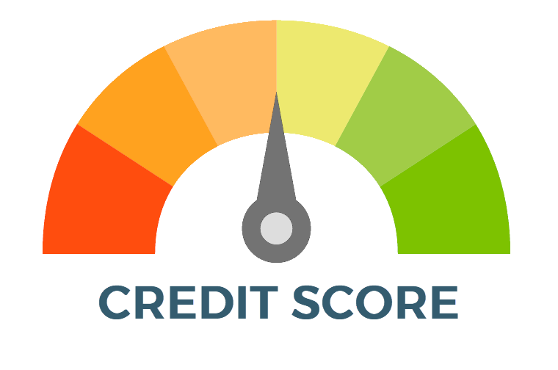
Credit – Keeping Promises
Have you ever borrowed money from someone?
What kind of agreement did you make with them about paying the money back?
Has anyone ever borrowed money from you and didn’t pay you back?
Notes:
Start the lesson with the following opening questions:
How do you know if someone will keep a promise? If someone were to break a promise, how would you feel the next time they make a promise?
Have you ever borrowed money from someone? What kind of agreement did you make with them about paying the money back?
Encourage the participants to share their answers.

Slide 3
Video - Credit
Notes:
CLICK THE VIDEO TO PLAY THE ‘WHAT IS CREDIT?’ VIDEO. TO PAUSE, CLICK THE VIDEO AGAIN.
Talking points for the class:
-Clarify what a Lender is. It could be a Bank, Credit Card or Mortgage company. There are different types of lenders.
-If you do a careful job of managing your money over time, you’ll gain the ability to borrow money when you need it.
-This ability to borrow money is called having credit.
Share the following key points to help students understand the importance of credit and interest:
Credit refers to the ability of a person or a business to borrow money from a lender with the intent or promise to pay the money back, usually with interest.
To earn credit, you first have to show lenders that you’re a good money manager.
When you borrow money from a parent, guardian, neighbor, or friend, you usually promise to pay it back by a certain time. They lend you the money because they trust you to keep your promise.

Slide 4
Credit
Credit is the ability to borrow money from a lender with the promise to pay the money back, usually with interest.
Earning credit requires earning people’s trust.
Notes:
Share the following key points to help students understand the importance of credit and interest:
Credit refers to the ability of a person or a business to borrow money from a lender with the intent or promise to pay the money back, usually with interest.
To earn credit, you first have to show lenders that you’re a good money manager.
When you borrow money from a parent, guardian, neighbor, or friend, you usually promise to pay it back by a certain time. They lend you the money because they trust you to keep your promise.

Slide 5
Personal Responsibility
Keep your promise to pay back the money you owe.
Credit is a privilege.
Credit can give you added flexibility to buy things.
Notes:
Share the following key points:
Taking personal responsibility means keeping your promise to pay back the money you owe.
Not everyone can borrow money from a bank. Credit is a privilege—and it’s granted only to those who have demonstrated their ability to manage their money.
Credit can give you added flexibility to buy things when you need them—but you should only use credit if your budget shows you can pay the money back.

Slide 6
Credit Cards
Credit limit = maximum amount you can borrow
Minimum payment = least amount you can pay
Pay the money back all at once or in monthly payments.
If you pay it back over time, you have to pay interest.
Notes:
Share the following key points:
When you borrow money from a bank, the bank is giving you credit.
One type of credit is a loan—for example, borrowing money to buy a car. Another type of credit is in the form of credit cards.
Adults can apply for credit cards. When you have a credit card, it means the lender is lending you money and allowing you to pay it back over time.
But the lender typically puts a limit on how much you may spend or charge on your card. This is called your credit limit or spending limit.
When you have a credit card, each month you have to pay what’s called the minimum payment. The lender will calculate how much that is. The minimum is the least amount of money you can pay on your credit card every month.
Share the following key points:
When you use a credit card—say, to purchase a video game—you’re taking responsibility to pay the money back.
You can pay it all at once or in monthly payments. But—if you pay it back over time, then you have to pay interest.
With credit, like loans and credit cards, you have to pay interest. And with credit cards, the interest rate can be very high.
Think about it: the slower you pay, the more interest you’ll have to pay every month. This interest is charged on every cent of the money you borrowed that you haven’t repaid yet.
So you see? When you buy something with a credit card and take time to pay it back, you end up paying more for your purchase than if you’d bought it with cash.
Credit cards are good when you’re buying something you know you can pay back quickly or for emergencies.
Different credit cards have different interest rates—so shop around for a card with a low rate.

Slide 7
Loans
Borrow all the money up front.
Pay it back within a specific period of time.
You have to pay interest.
Notes:
Share the following key points:
With loans, you borrow all the money up front—all at once—and pay it back within a specific period of time.
With loans, you also have to pay interest—but it’s usually less interest than you’d pay with a credit card.
It’s good to shop around for a loan with the lowest interest rate.
Loans are great if you’re buying very expensive things like cars or homes, or paying for a college education.

Slide 8
Video – Loans
Notes:
Watch the video with participants to give a quick overview of what loans and borrowing are. Ask them what the difference is between loans and credit cards.

Slide 9
Credit History
Lenders find credit history and scores from the following credit agencies:
EQUIFAX
TRANSUNION
EXPERIAN
Credit Agencies Track
How much you owe
Whether you pay your bills on time
Different types and number of credit accounts you have
Where you live/work and how long you’ve lived/worked there
Notes:
Tell participants that the three main credit agencies for credit reports are Equifax, Transunion and Experian. Let them know what the companies track.

Slide 10
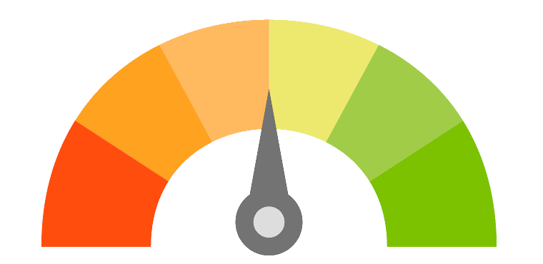
Your Credit Score
Like your credit history, lenders may look at your Credit Score. A Credit Score is a number that indicates how reliable you are at paying your debts.
A program analyzes your credit history and generates a single number score, usually between 300 to 850.
This score helps lenders decide if you are a good credit risk or not.
The higher the credit score, the better.
Lenders may charge lower interest rates to borrowers with higher credit scores.
What goes into your credit score:
Types of Credit
What You Owe
Length of Credit History
Payment Track Record
300
850
Notes:
Review the basics of credit scores with participants.

Slide 11
Quiz Time!
Q1: True or False – When I use my credit card to make a purchase I am borrowing money?
True
True
False
Q2: The term Interest Rate refers to:
a.
Amount of credit I have available on the card.
The interest rate set by the government for credit cards.
My annual fee for having this rewards card.
What is used to compute my finance charge.
b.
c.
d.
d.
Notes:
Presenter Notes/Comments:
Question 1
Ask the participants the first question. Give them time to answer. The correct answer is TRUE. Explain to participants that you are borrowing money from the credit card company when you use your card.
Question 2
The answer is D. This is the interest rate that is used to calculate the amount of interest to be charged on all or part of the balance if the full amount is not paid on or before the due date. The lower the APR means the lower the cost of the loan to you.

Slide 12
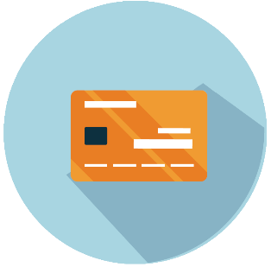
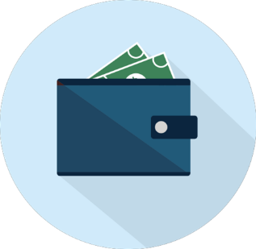
Wrap-up
Be smart about managing your credit
Shop for credit
Keep track of charges
Plan your shopping
Pay on time
Set limit and stick to them!
Get help early if you can’t meet your credit obligations
Be aware of credit trouble signs
Paying late
Ignoring savings
Bouncing checks
Maxing out credit
Experiencing stress over finances
Feeling like you’re paying forever
Notes:
Paying late
You’re frequently late in paying your bills and may be juggling payments to keep creditors satisfied.
Ignoring savings
You don’t have a savings account, or have stopped making deposits to it.
Bouncing checks
Your checking account is frequently overdrawn. You may find yourself racing to deposit your paycheck because you’ve already written checks that require the money in your paycheck to cover them.
Maxing out credit
Your credit accounts are usually at their maximum limits, and you are tempted to apply for more credit cards because you have reached the limit on the ones you have.
Experiencing personal stress over finances
You are always worried about your debts. You may have trouble sleeping or you may begin arguing with your spouse or partner over bills.
Feeling like you’re paying forever
You can make only minimum payments on your revolving charge accounts and you’re still paying off purchases you made a year ago.
Ignoring the phone
You ignore the telephone or mail to avoid dealing with creditors.
If you get into trouble, take action. Here are some tips:
Don’t ignore it! The problem won’t go away on its own.
Talk to your lender right away.
Get help—Your lender may be able to recommend a reputable credit counselor.
Know that credit management is a process—there is no quick fix.

Slide 13
Thank You / Feedback

Slide 14
Thank You / Links to Feedback Forms
Thank you for your support and commitment to providing financial education within our communities! To demonstrate our impact with the work you do, we are collecting volunteer and educator feedback.
Please go to the following page to enter feedback - https://handsonbanking.org/volunteerfeedback/.
Please have your participants go to the following webpage to submit their feedback - https://handsonbanking.org/participant-survey/.
The evaluation does not contain any personal information for participants or you. The evaluation will help us understand participants’ knowledge and confidence about money management topics and will help us better demonstrate the impact of our efforts.
Notes:
After class:
Take a few minutes to ask the teacher or program director how they thought the lesson went. Ask if there are other materials or information you could provide them.
Consider writing a thank you note as a follow-up to your visit.
Submit feedback on your experience at https://handsonbanking.org/employee-volunteer-feedback/
Go to https://wellsfargo.yourcause.com/ and record your volunteer hours.

